Slide 1
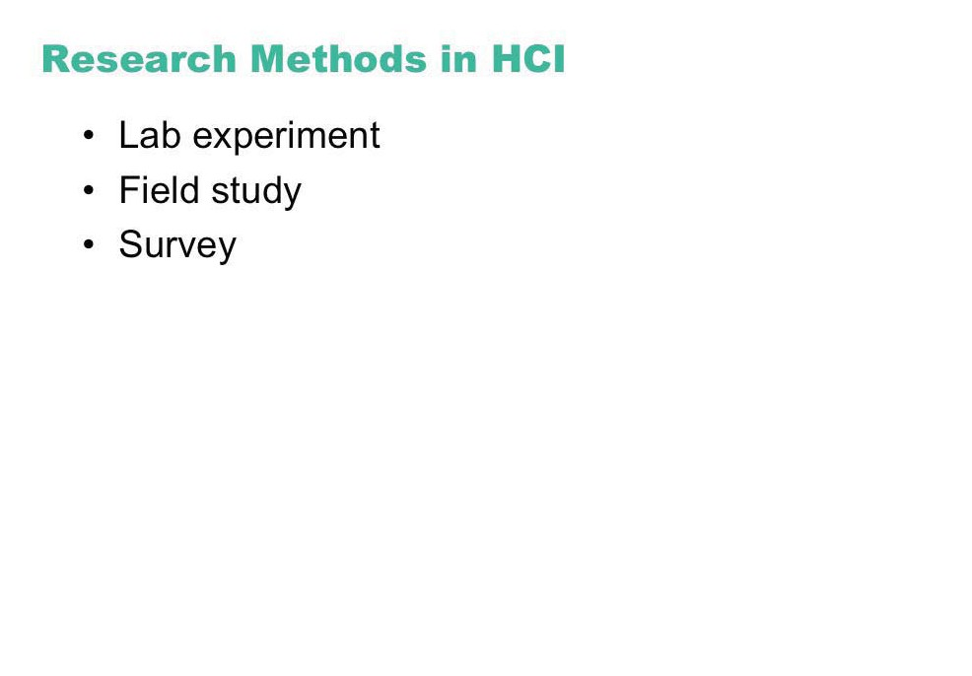

Slide 2
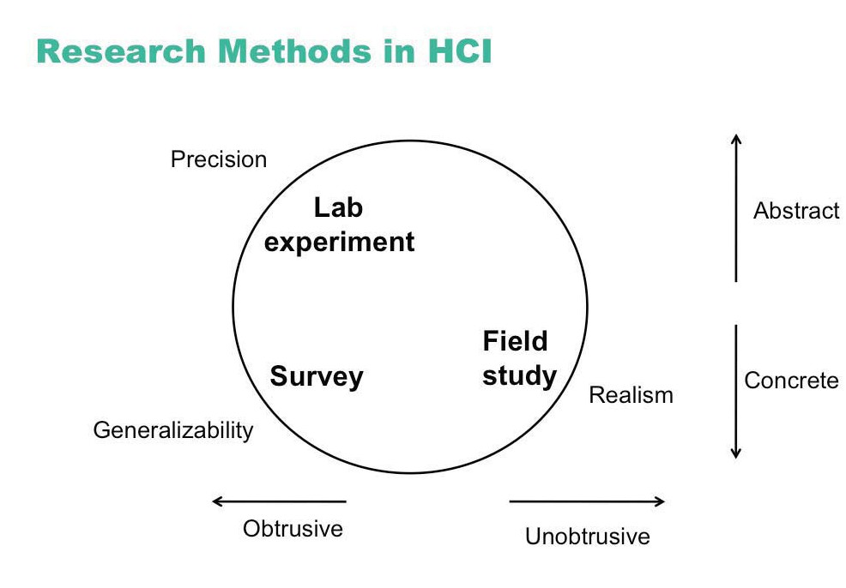

Slide 3
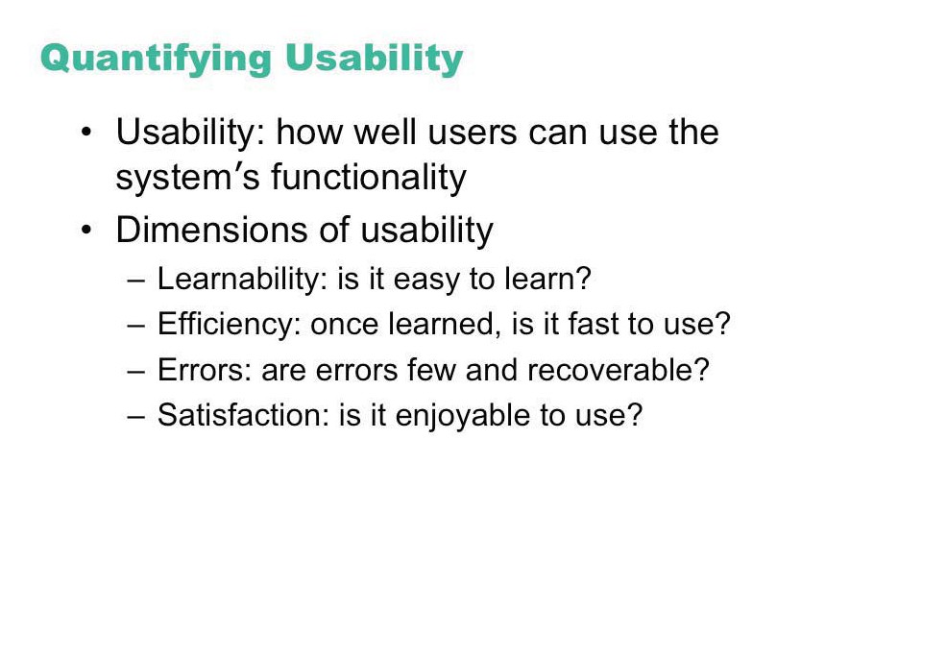

Slide 4
Controlled experiments
Traditional scientific method
Reductionist
clear convincing result on specific issues
In HCI:
insights into cognitive process, human performance limitations, ...
allows system comparison, fine-tuning of details ...
Notes:
4

Slide 5
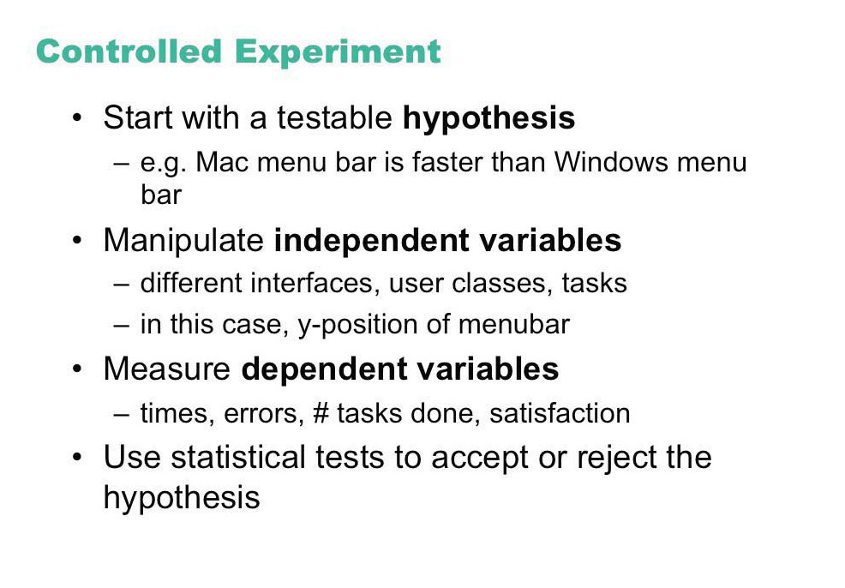

Slide 6
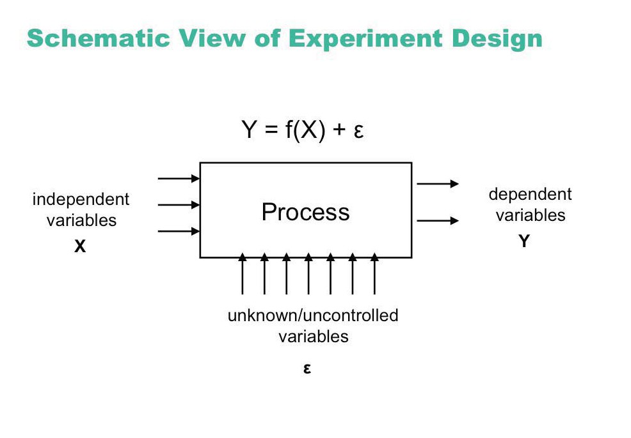

Slide 7
Lucid and testable hypothesis
State a lucid, testable hypothesis
this is a precise problem statement
Example 1:
There is no difference in the number of cavities in children and teenagers using crest and no-teeth toothpaste when brushing daily over a one month period
Notes:
7

Slide 8
Lucid and testable hypothesis
Example 2:
There is no difference in user performance (time and error rate) when selecting a single item from a pop-up or a pull down menu of 4 items, regardless of the subject’s previous expertise in using a mouse or using the different menu types
File Edit View Insert
File
New
New
Edit
Open
Open
View
Close
Close
Insert
Save
Save

Slide 9
Independent variables
in toothpaste experiment
toothpaste type: uses Crest or No-teeth toothpaste
age: <= 11 years or > 11 years
in menu experiment
menu type: pop-up or pull-down
menu length: 3, 6, 9, 12, 15
subject type (expert or novice)
Notes:
9

Slide 10
Dependent variables
in menu experiment
time to select an item
selection errors made
time to learn to use it to proficiency
in toothpaste experiment
number of cavities
preference
Notes:
10

Slide 11
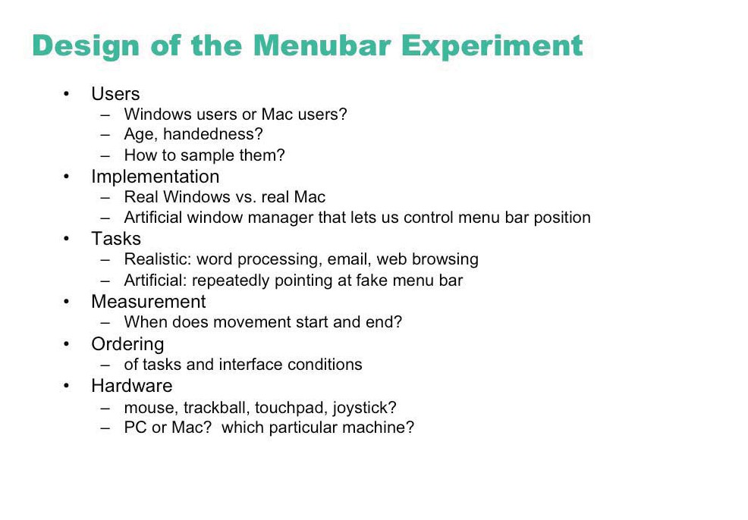

Slide 12
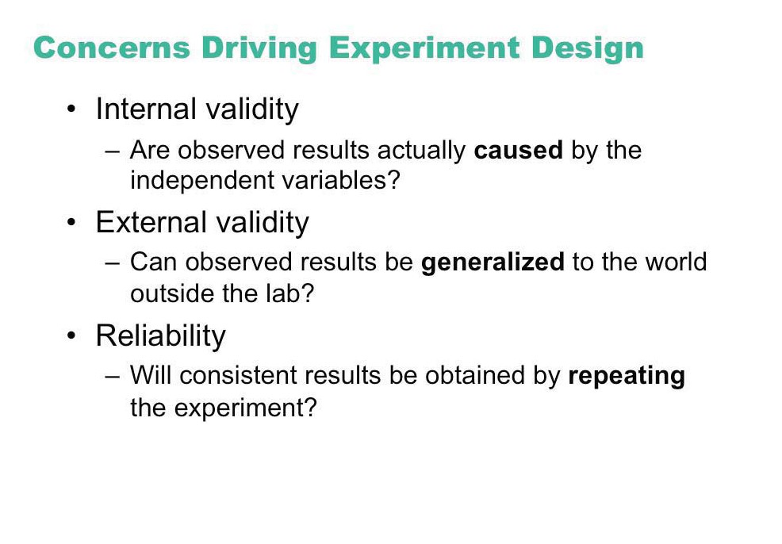

Slide 13
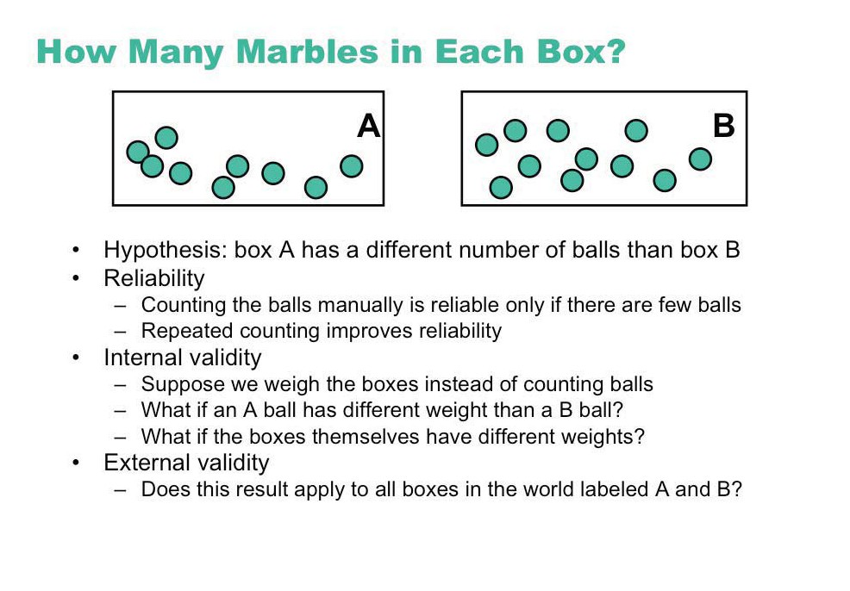

Slide 14
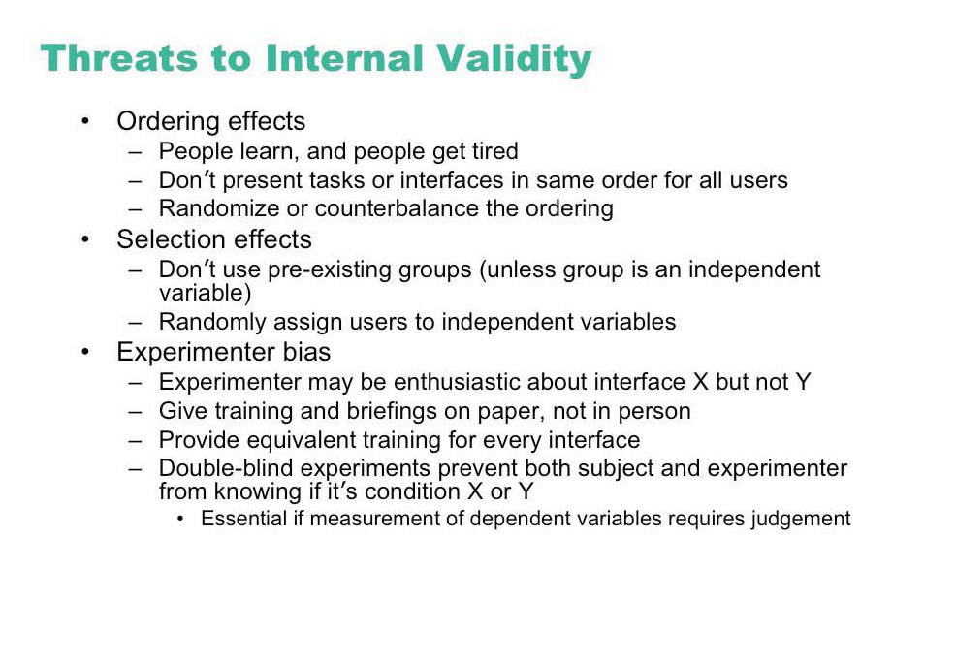

Slide 15
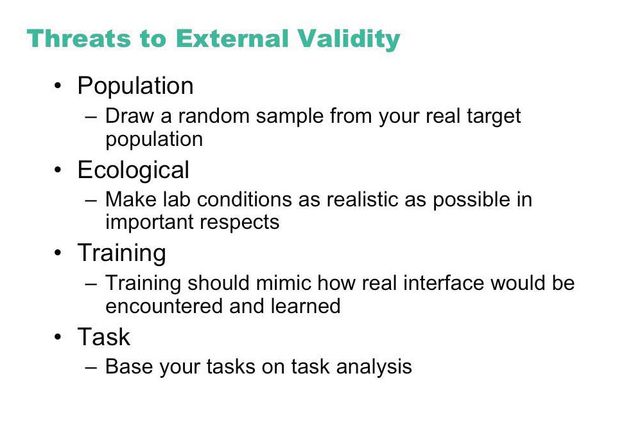

Slide 16

Subject Selection
Judiciously select and assign subjects to groups
ways of controlling subject variability
reasonable amount of subjects
random assignment
make different user groups an independent variable
screen for anomalies in subject group
superstars versus poor performers
Notes:
16

Slide 17
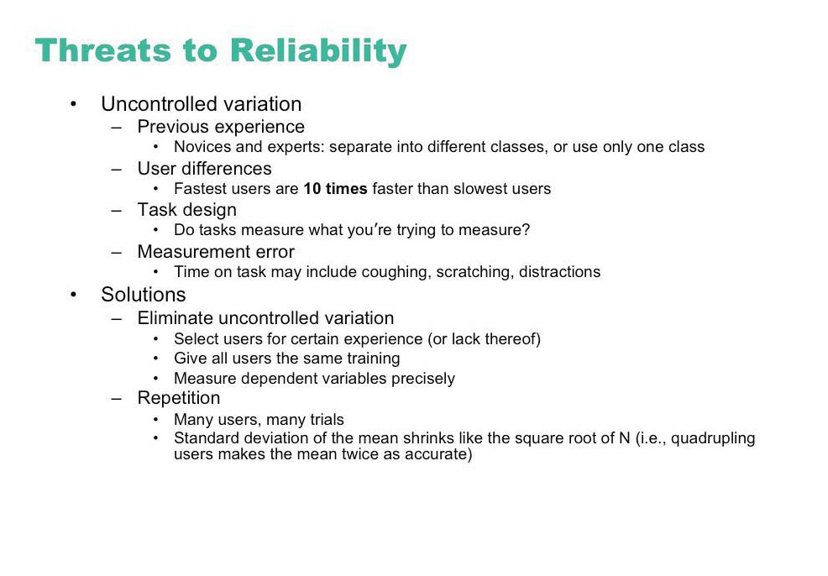

Slide 18

Controlling bias
Control for bias
unbiased instructions
unbiased experimental protocols
prepare scripts ahead of time
unbiased subject selection
Now you get to do the
pop-up menus. I think
you will really like them...
I designed them myself!
Notes:
18

Slide 19
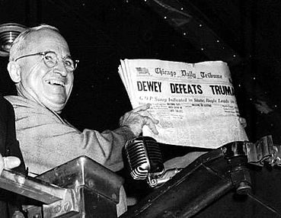
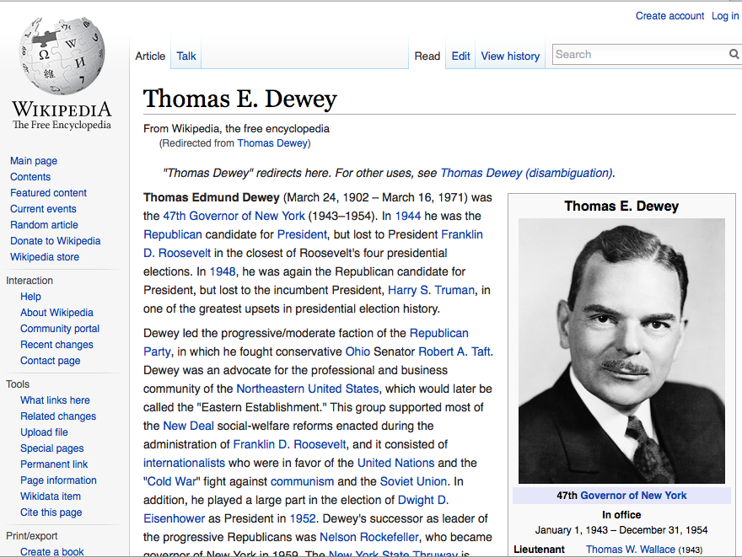
Sampling Bias: “Dewey Defeats Truman”

Slide 20
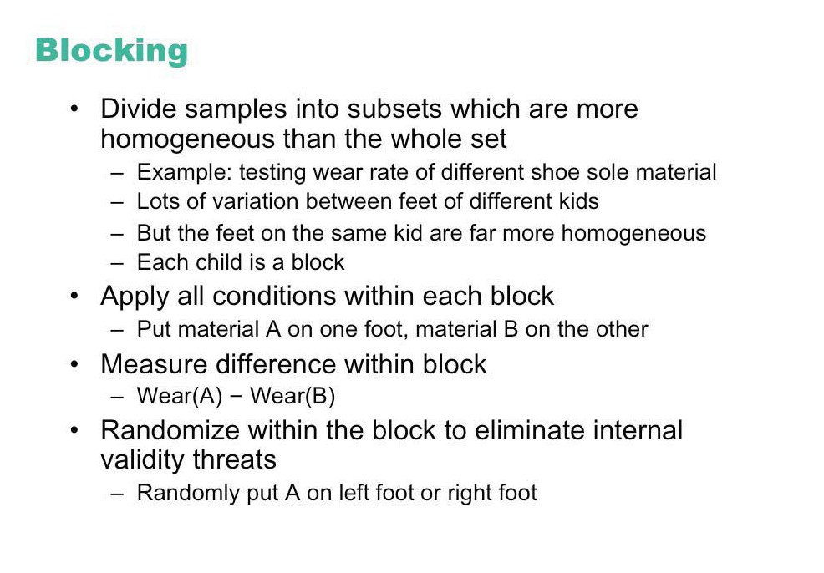

Slide 21
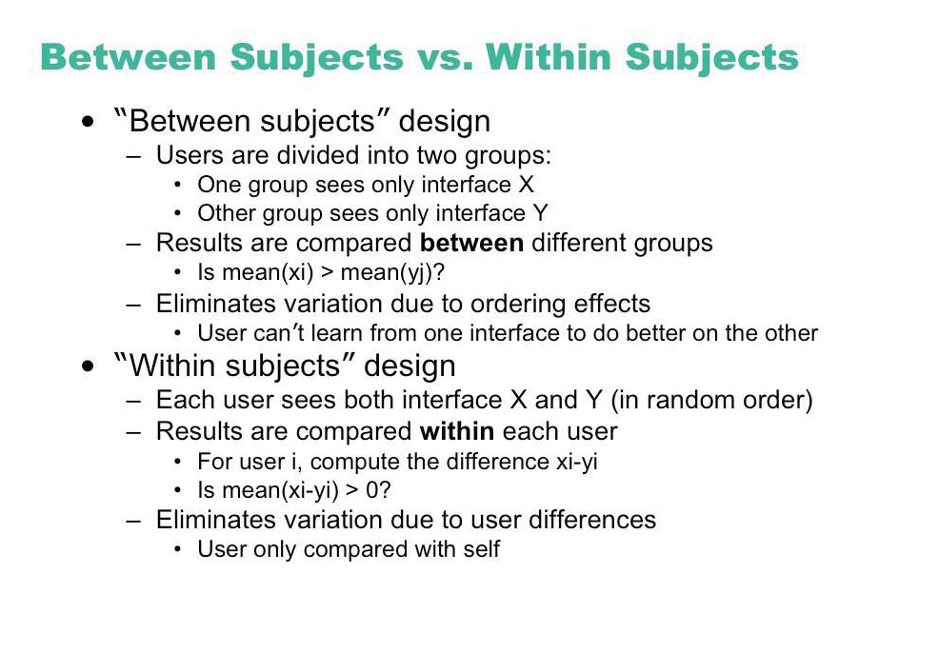

Slide 22
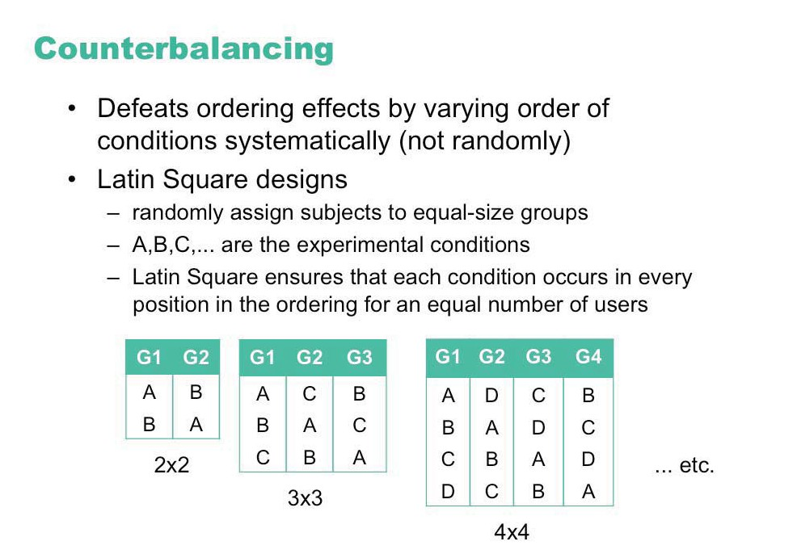

Slide 23
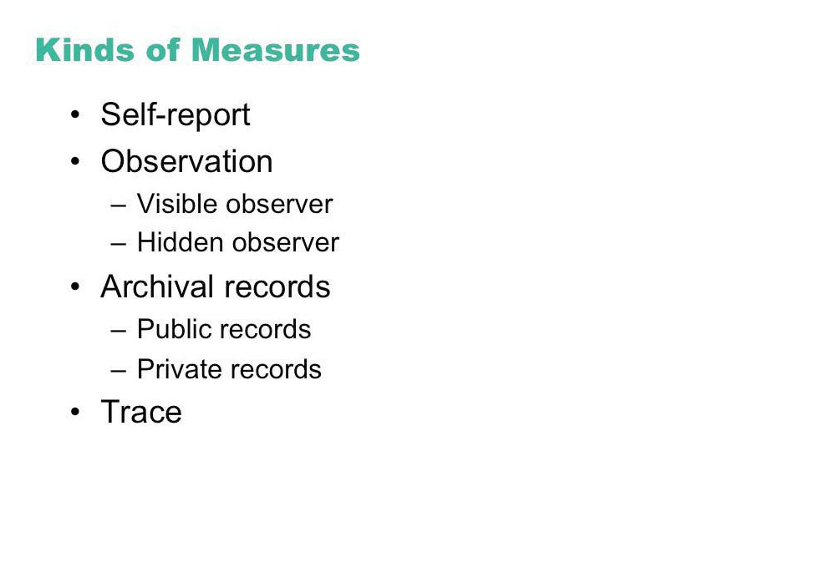

Slide 24
Statistical analysis
Apply statistical methods to data analysis
confidence limits:
the confidence that your conclusion is correct
“the hypothesis that computer experience makes no difference is rejected at the .05 level” means:
a 95% chance that your statement is correct
a 5% chance you are wrong
Notes:
24

Slide 25
Interpretation
Interpret your results
what you believe the results really mean
their implications to your research
their implications to practitioners
how generalizable they are
limitations and critique
Notes:
25

Slide 26
Example: Differences between means
Condition one: 3, 4, 4, 4, 5, 5, 5, 6
Given:
two data sets measuring a condition
height difference of males and females
time to select an item from different menu styles ...
Question:
is the difference between the means of this data statistically significant?
Null hypothesis:
there is no difference between the two means
statistical analysis:
can only reject the hypothesis at a certain level of confidence
Condition two: 4, 4, 5, 5, 6, 6, 7, 7
Notes:
26

Slide 27
Example:
mean = 4.5
3
2
Is there a significant difference between these means?
1
Condition one: 3, 4, 4, 4, 5, 5, 5, 6
0
3 4 5 6 7
Condition 1
Condition 1
3
mean = 5.5
2
1
Condition two: 4, 4, 5, 5, 6, 6, 7, 7
0
3 4 5 6 7
Condition 2
Condition 2
Notes:
27

Slide 28
Problem with visual inspection of data
Will almost always see variation in collected data
Differences between data sets may be due to:
normal variation
eg two sets of ten tosses with different but fair dice
differences between data and means are accountable by expected variation
real differences between data
eg two sets of ten tosses for with loaded dice and fair dice
differences between data and means are not accountable by expected variation
Notes:
28

Slide 29
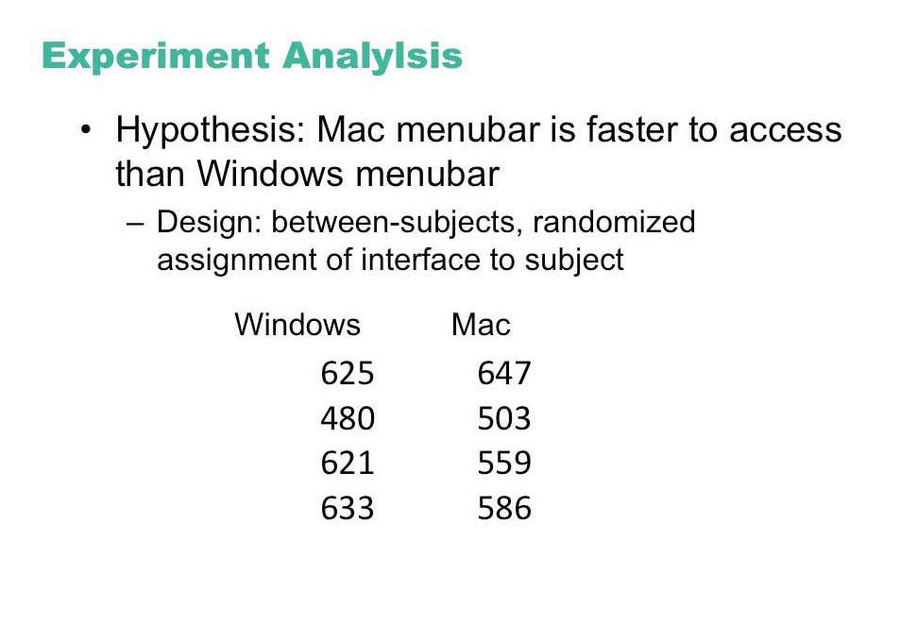

Slide 30
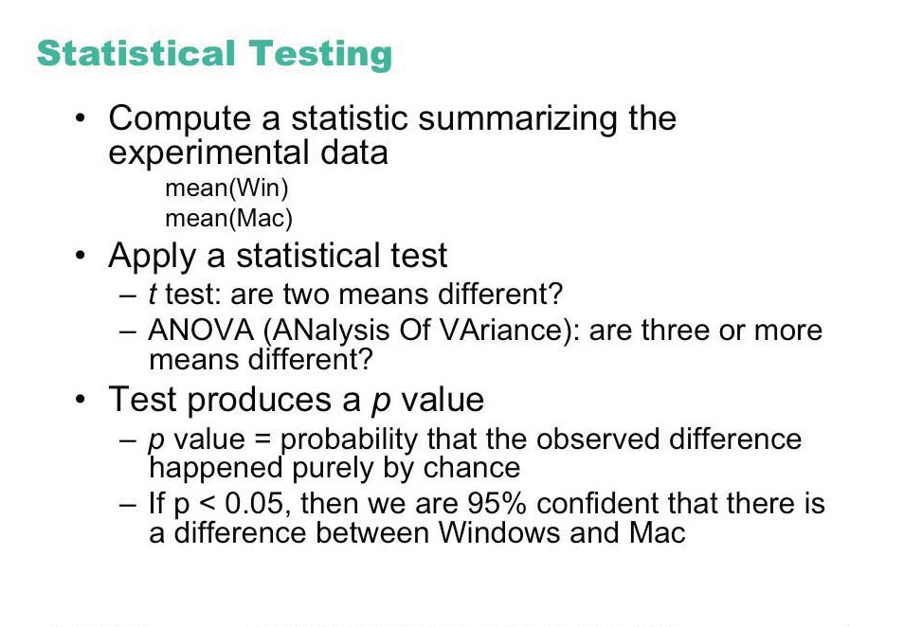

Slide 31
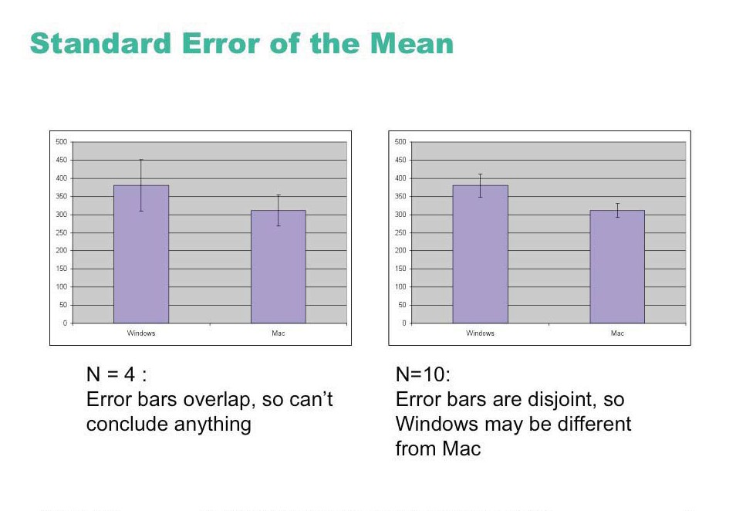

Slide 32
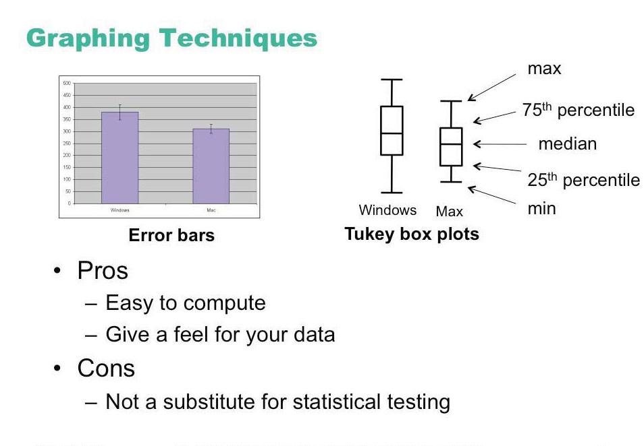

Slide 33
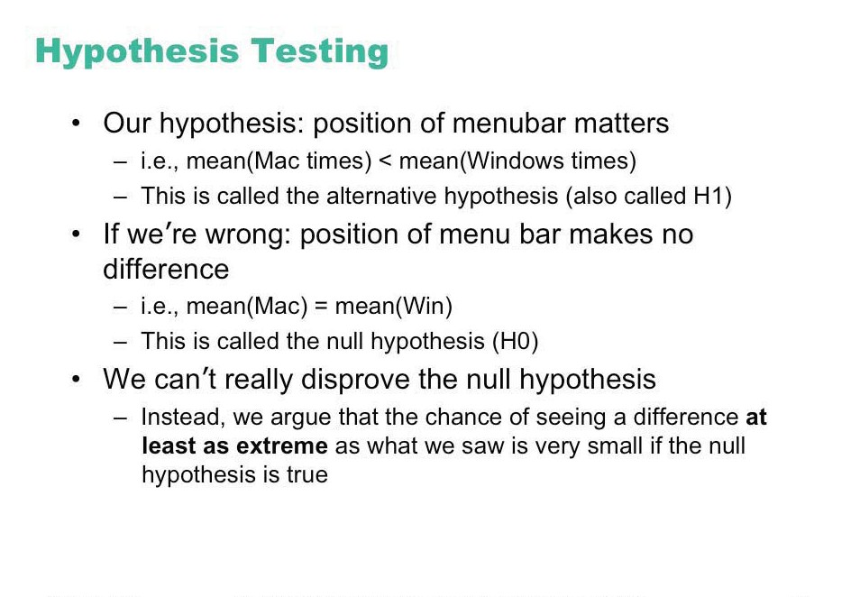

Slide 34
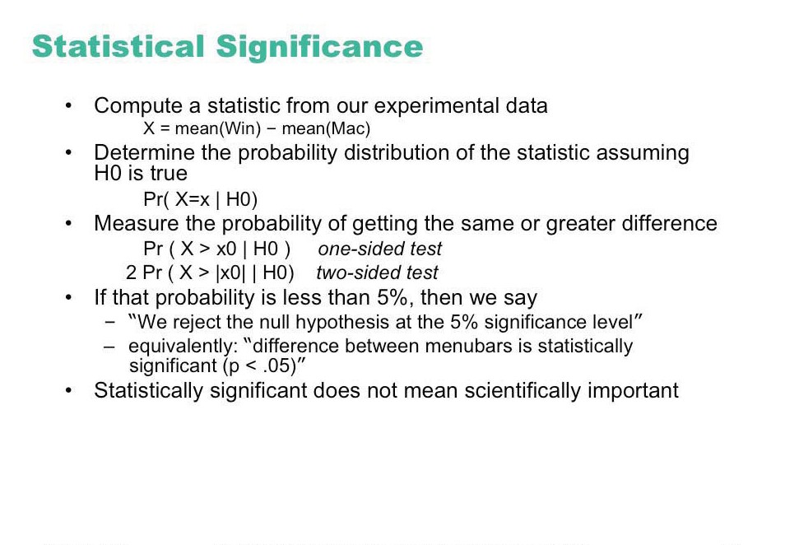

Slide 35
Statistical vs practical significance
When n is large, even a trivial difference may show up as a statistically significant result
eg menu choice: mean selection time of menu a is 3.00 seconds; menu b is 3.05 seconds
Statistical significance does not imply that the difference is important!
a matter of interpretation
statistical significance often abused and used to misinform
Notes:
35

Slide 36
T-test
A simple statistical test
allows one to say something about differences between means at a certain confidence level
Null hypothesis of the T-test:
no difference exists between the means of two sets of collected data
possible results:
I am 95% sure that null hypothesis is rejected
(there is probably a true difference between the means)
I cannot reject the null hypothesis
the means are likely the same
Notes:
36

Slide 37
Different types of T-tests
Comparing two sets of independent observations
usually different subjects in each group
number per group may differ as well
Condition 1 Condition 2
S1–S20 S21–43
Paired observations
usually a single group studied under both experimental conditions
data points of one subject are treated as a pair
Condition 1 Condition 2
S1–S20 S1–S20
Notes:
37

Slide 38
Different types of T-tests
Non-directional vs directional alternatives
non-directional (two-tailed)
no expectation that the direction of difference matters
directional (one-tailed)
Only interested if the mean of a given condition is greater than the other
Notes:
38

Slide 39
T-test...
Assumptions of t-tests
data points of each sample are normally distributed
but t-test very robust in practice
population variances are equal
t-test reasonably robust for differing variances
individual observations of data points in sample are independent
must be adhered to
Significance level
should decide upon the level before you do the test
typically stated at the .05 or .01 level
Notes:
39

Slide 40
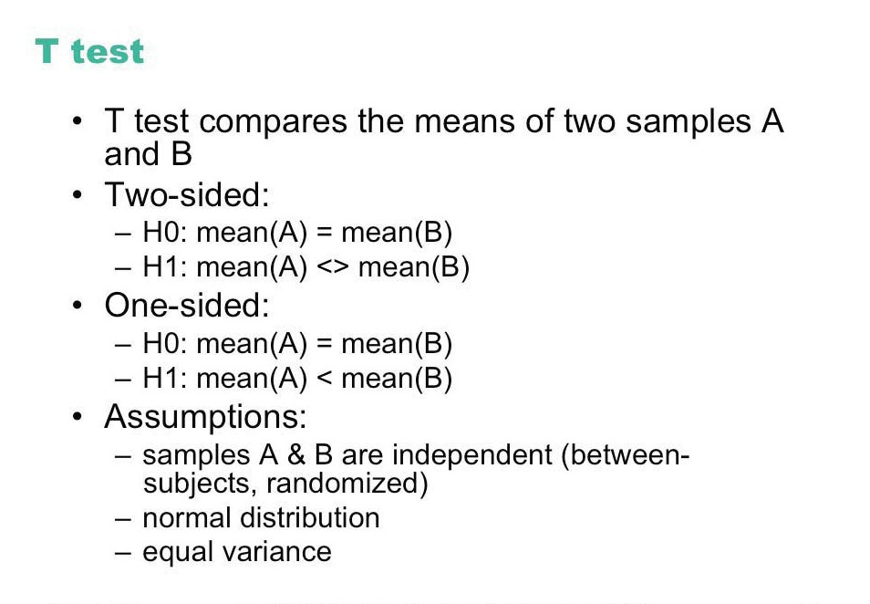

Slide 41
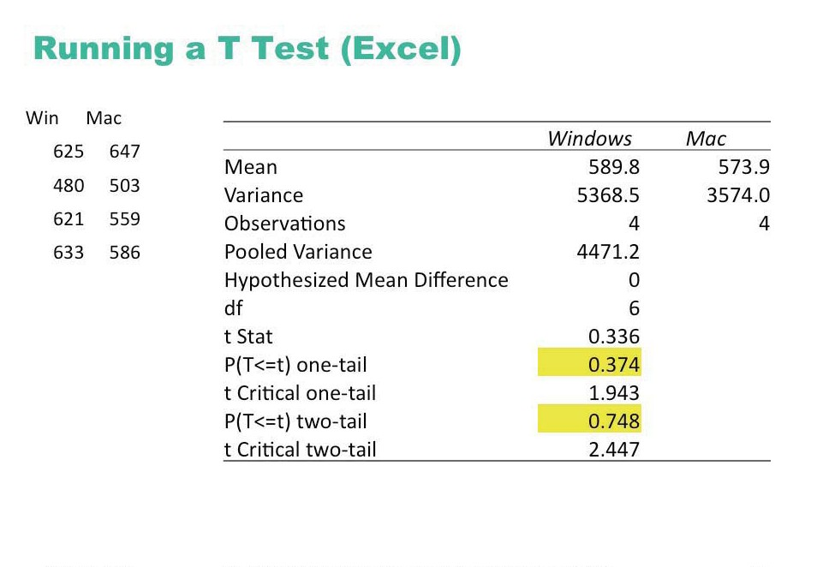

Slide 42
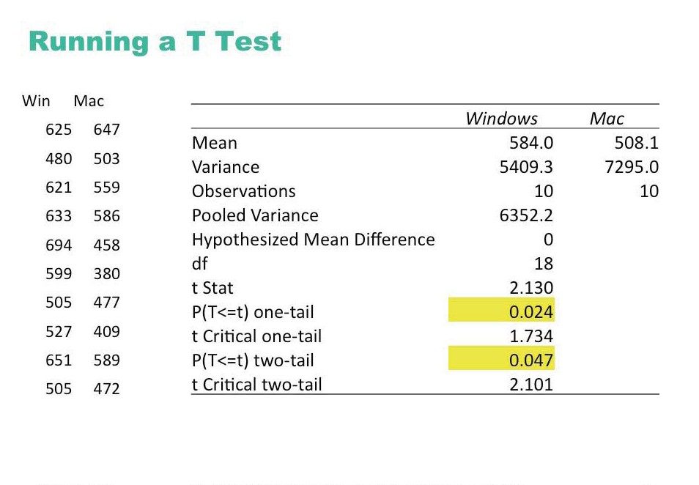

Slide 43
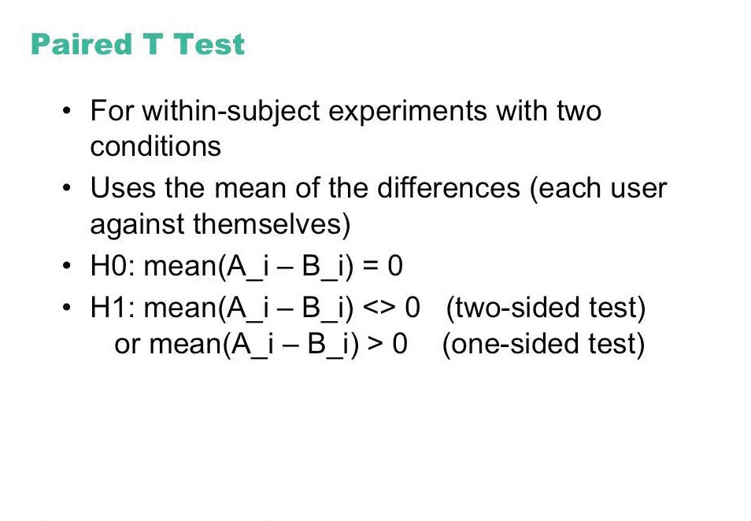

Slide 44
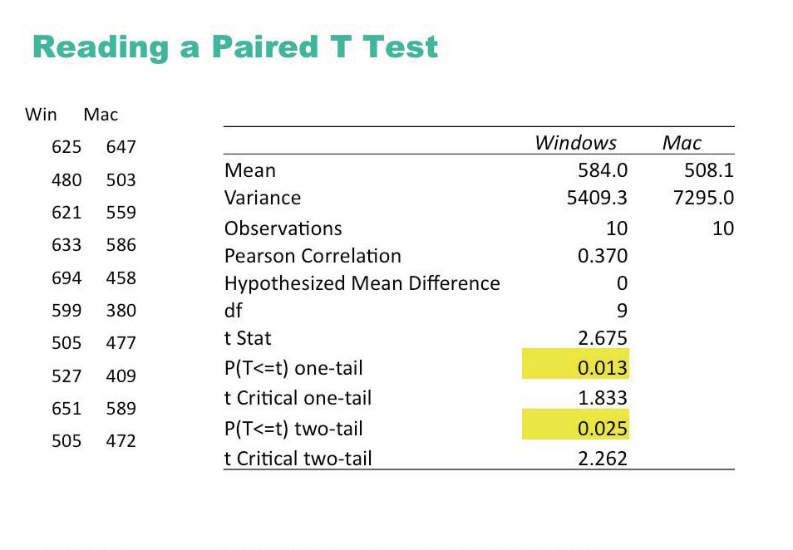

Slide 45
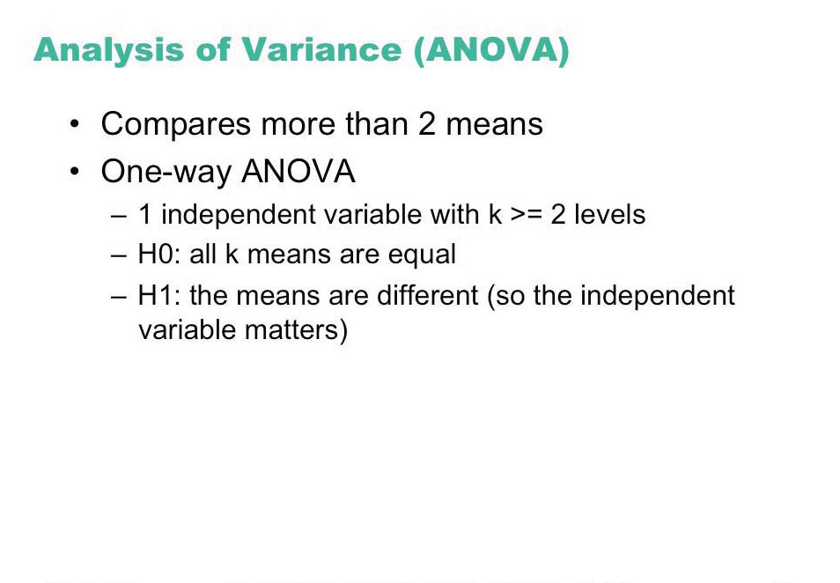

Slide 46
Analysis of Variance (Anova)
Compares relationships between many factors
Provides more informed results considers the interactions between factors
t-test for 2 means is degenerate case
example
beginners type at the same speed on both keyboards,
touch-typist type faster on the qwerty
Qwerty
Dvorak
cannot
S1-S10
S11-S20
touch type
can
S21-S30
S31-S40
touch type
Notes:
46

Slide 47
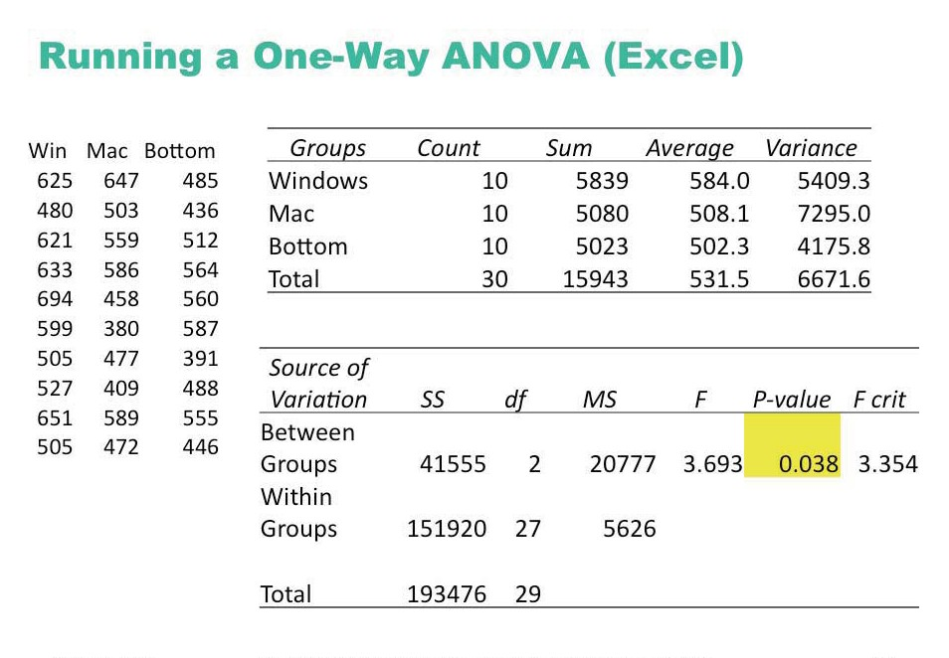

Slide 48
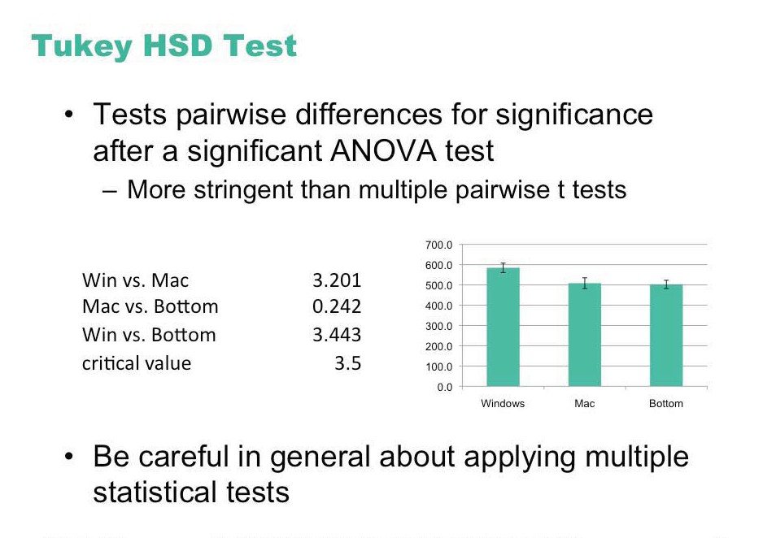

Slide 49
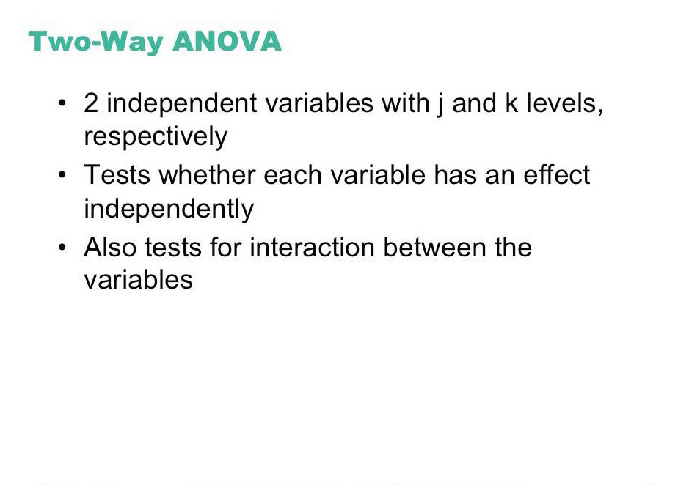

Slide 50
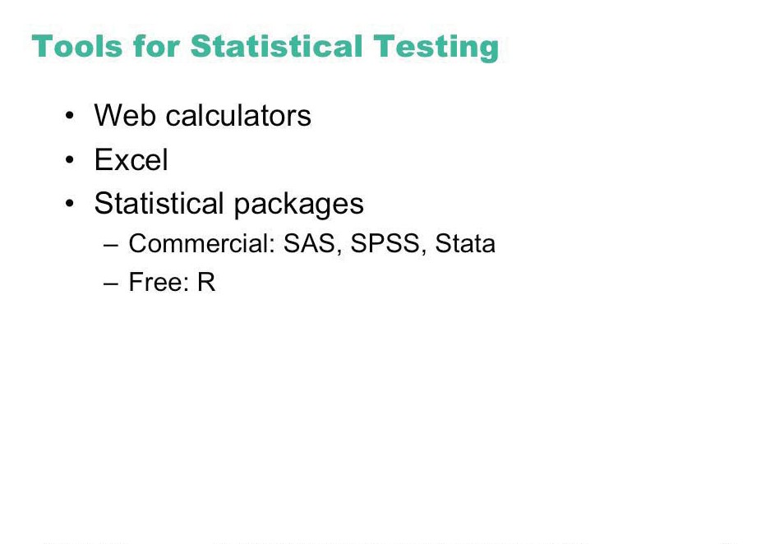

Slide 51
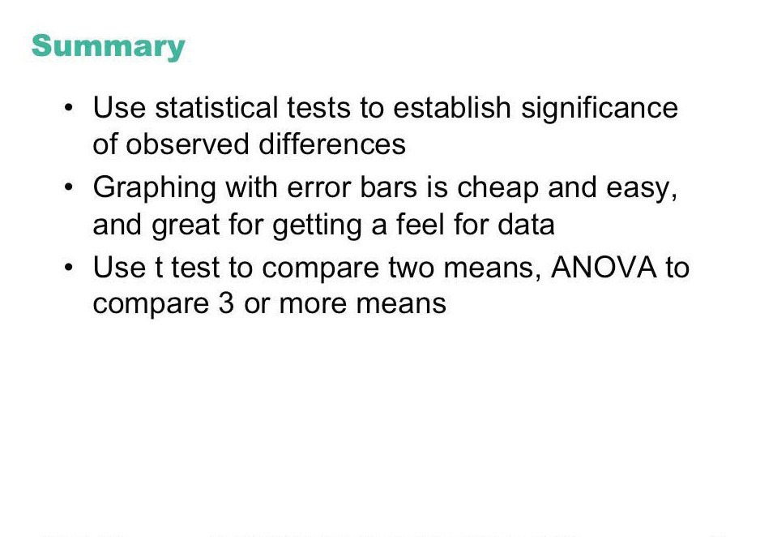

Slide 52
ANOVA Example
The Perceptual Structure of Multidimensional Input Device Selection

Slide 53
Type I and Type II Errors
Type 1 error
reject the null hypothesis when it is, in fact, true
Type 2 error
accept the null hypothesis when it is, in fact, false
Decision
 | False | True
True | Type I error | 
False |  | Type II error
“Reality”

Slide 54

Example: The SpamAssassin Spam Rater
A SPAM rater gives each email a SPAM likelihood
0: definitely valid email…
1:
2:
…
9:
10: definitely SPAM
SPAM likelihood
 1

Spam Rater
 3


5
 7
9
7

Slide 55

Example: The SpamAssassin Spam Rater
A SPAM assassin deletes mail above a certain SPAM threshold
what should this threshold be?
‘Null hypothesis’: the arriving mail is SPAM
<=X
 1

Spam Rater
 3


5
 7
>X
9
7

Slide 56
Example: The SpamAssassin Spam Rater
Low threshold = many Type I errors
many legitimate emails classified as spam
but you receive very few actual spams
High threshold = many Type II errors
many spams classified as email
but you receive almost all your valid emails
<=X
 1

Spam Rater
 3


5
 7
>X
9
7

Slide 57
Significance levels and errors
There is no difference between Pie and traditional pop-up menus
What is the consequence of each error type?
Type 1:
extra work developing software
people must learn a new idiom for no benefit
Type 2:
use a less efficient (but already familiar) menu
Which error type is preferable?
Redesigning a traditional GUI interface
Type 2 error is preferable to a Type 1 error
Designing a digital mapping application where experts perform extremely frequent menu selections
Type 1 error preferable to a Type 2 error
Close
Open
New
Save
New
Open
Close
Save
Notes:
57

Slide 58
Other tests: Correlation
Measures the extent to which two concepts are related
eg years of university training vs computer ownership per capita
How?
obtain the two sets of measurements
calculate correlation coefficient
+1: positively correlated
0: no correlation (no relation)
–1: negatively correlated
Notes:
58

Slide 59
Correlation
10
r² = .668
condition 1 condition 2
9
5
6
4
5
8
6
7
4
4
5
6
7
3
5
5
7
4
4
6
5
7
6
7
6
6
5
7
7
6
8
4
7
9
3
2.5
3
3.5
4
4.5
5
5.5
6
6.5
7
7.5
Condition 1
Condition 1
Notes:
59

Slide 60
Correlation
Dangers
attributing causality
a correlation does not imply cause and effect
cause may be due to a third “hidden” variable related to both other variables
drawing strong conclusion from small numbers
unreliable with small groups
be wary of accepting anything more than the direction of correlation unless you have at least 40 subjects
Notes:
60

Slide 61
Correlation
10
Pickles eaten per month
Salary per year (*10,000)
r² = .668
9
5
6
4
5
8
6
7
4
4
5
6
7
3
5
5
7
Salary per year (*10,000)
4
4
6
5
7
6
7
6
6
5
7
7
6
8
4
7
9
3
Which conclusion could be correct? -Eating pickles causes your salary to increase
-Making more money causes you to eat more pickles
-Pickle consumption predicts higher salaries because older people tend to like pickles better than younger people, and older people tend to make more money than younger people
2.5
3
3.5
4
4.5
5
5.5
6
6.5
7
7.5
Pickles eaten per month
Notes:
61

Slide 62
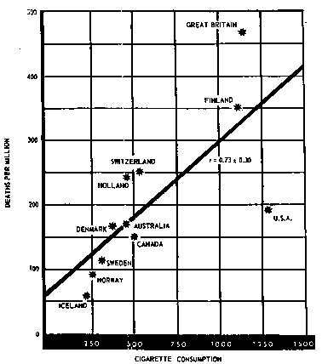
Correlation
Cigarette Consumption
Crude Male death rate for lung cancer in 1950 per capita consumption of cigarettes in 1930 in various countries.
While strong correlation (.73), can you prove that cigarrette smoking causes death from this data?
Possible hidden variables:
age
poverty

Slide 63
Other tests: Regression
Calculates a line of “best fit”
Use the value of one variable to predict the value of the other
e.g., 60% of people with 3 years of university own a computer
10
y = .988x + 1.132, r2 = .668
y = .988x + 1.132, r2 = .668
9
condition 1 condition 2
5
6
8
4
5
6
7
4
4
7
5
6
Condition 2
3
5
6
5
7
4
4
5
7
5
6
7
6
6
7
7
4
6
8
7
9
3
3
4
5
6
7
Condition 1
Notes:
63

Slide 64
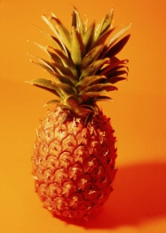
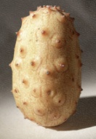
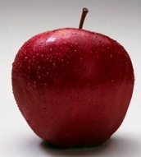
Nominal Scale
Classification into named or numbered unordered categories
country of birth, user groups, gender…
Allowable manipulations
whether an item belongs in a category
counting items in a category
Statistics
number of cases in each category
most frequent category
no means, medians…
With permission of Ron Wardell
Notes:
64

Slide 65


Ordinal Scale
Classification into named or numbered ordered categories
no information on magnitude of differences between categories
e.g. preference, social status, gold/silver/bronze medals
Allowable manipulations
as with interval scale, plus
merge adjacent classes
transitive: if A > B > C, then A > C
Statistics
median (central value)
percentiles, e.g., 30% were less than B
Sources of error
as in nominal
With permission of Ron Wardell
Notes:
65

Slide 66


Interval Scale
Classification into ordered categories with equal differences between categories
zero only by convention
e.g. temperature (C or F), time of day
Allowable manipulations
add, subtract
cannot multiply as this needs an absolute zero
Statistics
mean, standard deviation, range, variance
Sources of error
instrument calibration, reproducibility and readability
human error, skill…
With permission of Ron Wardell
Notes:
66

Slide 67
Ratio Scale
Interval scale with absolute, non-arbitrary zero
e.g. temperature (K), length, weight, time periods
Allowable manipulations
multiply, divide
With permission of Ron Wardell
Notes:
67

Slide 68
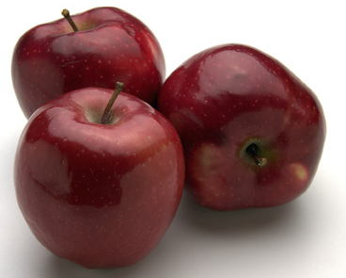
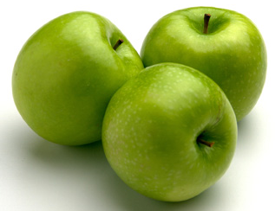
Example: Apples
Nominal:
apple variety
Macintosh, Delicious, Gala…
Ordinal:
apple quality
US. Extra Fancy
U.S. Fancy,
U.S. Combination Extra Fancy / Fancy
U.S. No. 1
U.S. Early
U.S. Utility
U.S. Hail
With permission of Ron Wardell
Notes:
68

Slide 69
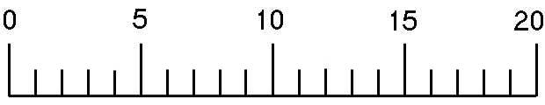
Example: Apples
Interval:
apple ‘Liking scale’ Marin, A. Consumers’ evaluation of apple quality. Washington Tree Postharvest Conference 2002.
After taking at least 2 bites how much do you like the apple?
Dislike extremely Neither like or dislike Like extremely
Ratio:
apple weight, size, …
With permission of Ron Wardell
Notes:
69

